Slide 1
Introduction to Requirements Elicitation
CSE-478 (Fall 2011)

Slide 2
Key Points
Goals, Risks, and Challenges
Sources of Requirements
Requirements Elicitation Tasks
Elicitation Problems

Slide 3
Goals, Risks, and Challenges

Slide 4
What is Requirements Elicitation?
Goals, Risks, and Challenges Sources of Requirements Requirements Elicitation Tasks Elicitation Problems
Elicitation means “to bring out, to evoke, to call forth”
Requirements elicitation is “the process of discovering the requirements for a system by communicating with customers, system users and others who have a stake in the system development”¹
[1] Ian Sommerville and Pete Sawyer

Slide 5
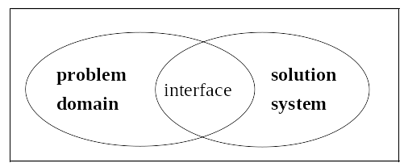
Elicitation Goals
Goals, Risks, and Challenges Sources of Requirements Requirements Elicitation Tasks Elicitation Problems
Determine sources of information & appropriate techniques
Get information on domain, problem, constraints
  → requirements → system development
Produce a first document
  Mainly user requirements and elicitation notes
  Potentially incomplete, disorganized, inconsistent
  But we must start somewhere!
Specification
  description of Solution System needed to
  satisfy Problem Domain
Hardware
Software
Domain
properties
Requirements

Slide 6

Elicitation Risks and Challenges (1)
Goals, Risks, and Challenges Sources of Requirements Requirements Elicitation Tasks Elicitation Problems
You need to extract information from the brain of
your customer without damaging the customer,
much less his brain!
Problems!
Scope
  System boundaries inadequately defined or defined too soon
  Unnecessary technical details
Understanding
  Stakeholder not sure of what is needed
  Stakeholder has trouble communicating needs
  Stakeholder does not understand capabilities and limitation of computing environment

Slide 7
Elicitation Risks and Challenges (2)
Goals, Risks, and Challenges Sources of Requirements Requirements Elicitation Tasks Elicitation Problems
Understanding (cont’d)
  Stakeholder does not have full understanding of domain
  Stakeholders state conflicting requirements
Volatility
  Stakeholders will not commit to a set of written requirements

Slide 8

Elicitation Risks and Challenges (3)
Goals, Risks, and Challenges Sources of Requirements Requirements Elicitation Tasks Elicitation Problems
Other typical issues
  Experts seldom available
  Finding an adequate level of precision/detail
  Common vocabulary often missing
Requirements do not fall from the sky!
  Sometimes hidden
  Sometimes too obvious, implicit, ordinary…
Notes:
Participants often lack motivation and resist to change
We need much effort and discussion to come up with a
common agreement and understanding!

Slide 9
“Ignorance is a bliss”¹
Goals, Risks, and Challenges Sources of Requirements Requirements Elicitation Tasks Elicitation Problems
According to Prof. Dan Berry (University of Waterloo), ignorance of a domain is a good thing!
Ignorance (not stupidity !) allows one to expose hypotheses and some implicit facts
Berry even suggests that one day, requirements engineers may advertise their domains of ignorance (rather than their domains of expertise) to find a job!
[1] The Matrix, 1999

Slide 10
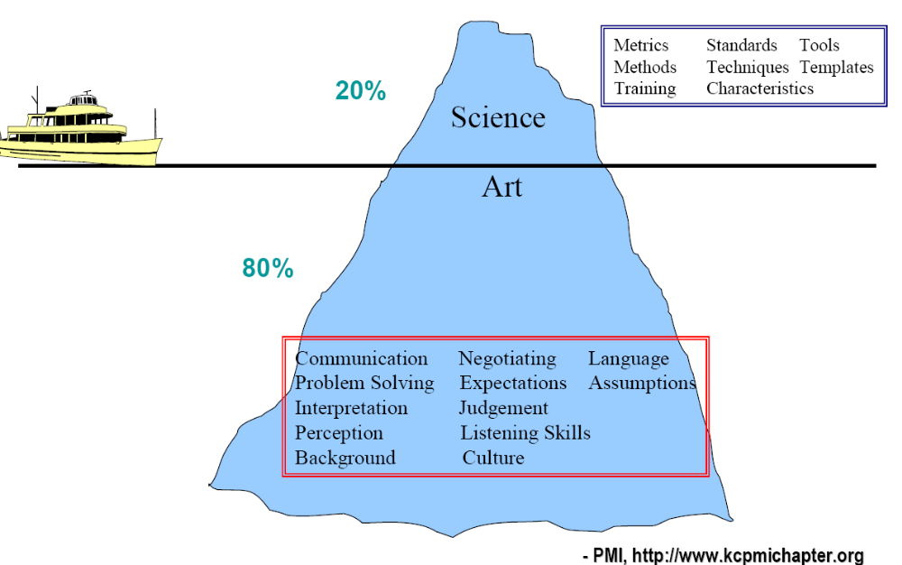
RE: More an Art than Science
Goals, Risks, and Challenges Sources of Requirements Requirements Elicitation Tasks Elicitation Problems

Slide 11
Sources of Requirements

Slide 12
Sources of Requirements
Goals, Risks, and Challenges Sources of Requirements Requirements Elicitation Tasks Elicitation Problems
Various stakeholders
  Clients, customers, users (past and future), buyers, managers, domain experts, developers, marketing and QA people, lawyers, people involved in related systems, anyone who can bring added value!
Pre-existing systems
  Not necessarily software systems
Pre-existing documentation
Competing systems
Documentation about interfacing systems
Standards, policies, collective agreements, legislation

Slide 13
Stakeholder – Customer/Client
Goals, Risks, and Challenges Sources of Requirements Requirements Elicitation Tasks Elicitation Problems
Person who pays for the software development
Ultimately, has the final word on what will be the product
For an internal product, the client is probably a product manager
For the consumer market, the customer may be the marketing department

Slide 14
Stakeholder – Buyer
Goals, Risks, and Challenges Sources of Requirements Requirements Elicitation Tasks Elicitation Problems
Person who pays for the software once it is developed
Possibly a user or a business owner buying a product for his employees
What features is he willing to pay for?
  Which are trivial or excessive?
Must participate actively in the project (or have a representative)

Slide 15
Stakeholder – User
Goals, Risks, and Challenges Sources of Requirements Requirements Elicitation Tasks Elicitation Problems
... of the current system or future systems
Experts of the current system: indicate which functions to maintain or improve
Experts of competitors’ products: suggestions on designing a superior product
May have special needs or requirements
  Usability, training, online help ...
Do not neglect interest groups
  Expert users, or with disabilities or handicaps
Select users with care
  Different seniority
  Must speak with authority and be responsible and motivated

Slide 16
Stakeholder – Domain Expert
Goals, Risks, and Challenges Sources of Requirements Requirements Elicitation Tasks Elicitation Problems
Expert who knows the work involved
Familiar with the problem that the software must solve. For example:
  Financial expert for finance management software
  Aeronautical engineers for air navigation systems
  Meteorologist for weather forecasting system, etc…
Also knows the environment in which the product will be used

Slide 17
Stakeholder – Software Engineer
Goals, Risks, and Challenges Sources of Requirements Requirements Elicitation Tasks Elicitation Problems
Expert who knows the technology and process
Determines if the project is technically and economically feasible
Specifically estimates the cost and time of product development
Educates the buyer/client on the latest and innovative hardware or software, and recommends new features that will benefit from these technologies

Slide 18
Stakeholder – Other
Goals, Risks, and Challenges Sources of Requirements Requirements Elicitation Tasks Elicitation Problems
Inspector
  An expert in governmental rules and safety relevant to the project
  Examples: safety inspectors, auditors, technical inspectors, government inspectors
Market research specialist
  Can play the role of the customer if the software is developed for the general public
  Expert who has studied the market to determine trends and needs of potential customers

Slide 19
Stakeholder – Other
Goals, Risks, and Challenges Sources of Requirements Requirements Elicitation Tasks Elicitation Problems
Lawyer
  Familiar with laws and legal aspects
  Standards relevant to the project
Expert of systems that interact with the system to be built
  Knows the interfaces of the interacting systems
  May be interested in product features (if the product can help the interacting system to perform its tasks)
Others that bring added value
  People who will use your product as a basic building block

Slide 20
Stakeholders Availability…
Goals, Risks, and Challenges Sources of Requirements Requirements Elicitation Tasks Elicitation Problems
Stakeholders are generally busy!
  Have priorities other than you
  Are rarely entirely disconnected from their daily routine and tasks
  See their participation in the elicitation process as a supplementary task
Hence, you must have the support and commitment of managers (especially theirs!)
You must also avoid being perceived as a threat:
  Loss of jobs caused by the improved system
  Loss of autonomy, powers, or privileges
  To the recognition and visibility of their work

Slide 21
Requirements Elicitation Tasks

Slide 22
Tasks Performed as Part of Elicitation (1)
Goals, Risks, and Challenges Sources of Requirements Requirements Elicitation Tasks Elicitation Problems
Planning for the elicitation
  Why? Who? When? How? Risks?
During the elicitation
  Examine the viability of the project (is it worth it?)
  Understand the problem from the perspective of each stakeholder
  Extract the essence of stakeholders’ requirements
  Invent better ways to do the work of the user
Following the elicitation
  Analyse results to understand obtained information
  Negotiate a coherent set of requirements acceptable by all stakeholders and establish priorities
  Record results in the requirements specification

Slide 23
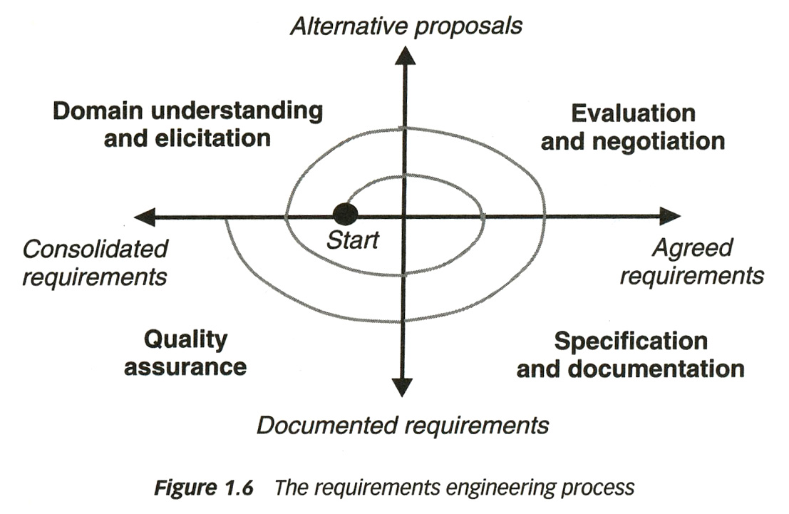
Tasks Performed as Part of Elicitation (2)
Goals, Risks, and Challenges Sources of Requirements Requirements Elicitation Tasks Elicitation Problems
Repeat as needed
Elicitation is incremental
  Driven by information obtained
  You always do a bit of elicitation – analysis – specification – verification at the same time

Slide 24
Planning for Elicitation
Goals, Risks, and Challenges Sources of Requirements Requirements Elicitation Tasks Elicitation Problems
Elicitation Plan should include:
  Objectives
  Strategies and processes
  Products of elicitation efforts
  Schedule and resource estimates
  Risks

Slide 25
Elicitation Plan – Objectives / Strategies & Processes
Goals, Risks, and Challenges Sources of Requirements Requirements Elicitation Tasks Elicitation Problems
Objectives: Why this elicitation?
  Validate market data
  Explore usage scenarios
  Develop a set of requirements, etc..
Set elicitation strategies and processes
  Approaches used
  Often a combination of approaches depending on the types and number of stakeholders
  Examples: Surveys (questionnaires)‏, workshops, interviews…

Slide 26
Elicitation Plan – Products
Goals, Risks, and Challenges Sources of Requirements Requirements Elicitation Tasks Elicitation Problems
Usually set of rough requirements
  Written, audio, video notes
  Documentation
Deliverables depend on objective and technique, e.g.
  Notes
  Goals
  List of use cases, scenarios
  A set of high-level requirements
  Detailed Software Requirements Specification (SRS)
  Analysis of survey results
  Performance attribute specification
  ...

Slide 27
Elicitation Plan – Estimates
Goals, Risks, and Challenges Sources of Requirements Requirements Elicitation Tasks Elicitation Problems
Identify development and customer participants in various elicitation activities
Estimate of effort for elicitation
Scheduling of resources

Slide 28
Elicitation Plan – Risks
Goals, Risks, and Challenges Sources of Requirements Requirements Elicitation Tasks Elicitation Problems
Factors that could obstruct completion of elicitation activities
  E.g., hostile stakeholders
Severity of each risk
Likelihood of occurrence for each risk
Improvement/Lessening strategy for each risk

Slide 29
Examine Project Viability
Goals, Risks, and Challenges Sources of Requirements Requirements Elicitation Tasks Elicitation Problems
Does-it make good business sense ?
  It's very difficult to cancel a project once started
Based on:
  Product's purpose
  Business advantage
  Costs vs. benefits
  Feasibility
  Scope
  Required resources
  Requirements constraints
  Risks

Slide 30
Project Viability – Purpose & Business Advantage
Goals, Risks, and Challenges Sources of Requirements Requirements Elicitation Tasks Elicitation Problems
Purpose
  What is the product? What does the product do?
  Highest-level customer requirement
  Business need
  All other requirements must contribute in some way to the purpose
Business advantage
  Why build the product?
  The purpose of the product should be not only to solve the problem, but also to provide a business advantage
  How will the product help the work?
  A problem can be expressed as a difficulty that customers or users are facing or as an opportunity to produce some benefit, e.g., increased productivity or sales
  Solving the problem leads to software development (or purchase)

Slide 31
Project Viability – Cost vs. Benefits
Goals, Risks, and Challenges Sources of Requirements Requirements Elicitation Tasks Elicitation Problems
Cost vs. benefits
  How much will the product help our work?
  How much will it cost to develop and operate the product?
  Are the expected benefits greater than the anticipated costs?
    Demonstrate! If not, stop the project!

Slide 32
Project Viability – Feasibility
Goals, Risks, and Challenges Sources of Requirements Requirements Elicitation Tasks Elicitation Problems
Feasibility
  One reason for describing measurable requirements as soon as possible is to answer questions about feasibility
  Technical feasibility
    Does the organization have the skills needed to build and operate the product?
    If not, stop the project
  Economic feasibility
    Does the organization have the resources (time, money, staff) to construct the product?
    If not, stop the project

Slide 33
Project Viability – Scope (1)
Goals, Risks, and Challenges Sources of Requirements Requirements Elicitation Tasks Elicitation Problems
Scope: product's purpose and the system's boundaries
  How much of the work will be done by the system-to-be-developed?
  How much of the work will be done by interacting systems?
Information needed for cost and time estimates
Define more precisely the problem to solve
  List all the things the system should have to do
  Exclude as much as possible to reduce the complexity of the problem
  Establish broader goals if the problem is too simple
  Example: an automated system for university registration
Initial list of wide problems
Reduced scope
For other systems
Course Browser
Room Allocation
Course Browser
Room Allocation
Registration
Registration
Exam Schedule
Exam Schedule
Payment
Payment
Later stage

Slide 34
Project Viability – Scope (2)
Goals, Risks, and Challenges Sources of Requirements Requirements Elicitation Tasks Elicitation Problems
The product vision for the kind of product it should be - may affect multiple projects
  Point of view of customer, business
  Evolves relatively slowly
The scope for a single project, defining and communicating clear limits on what to implement
  Important for the Project Manager
  More dynamic vision
  Can be found in a requirements document
The requirements provide an understanding of what is needed to meet business objectives
  Many changes!

Slide 35
Project Viability – Required Resources
Goals, Risks, and Challenges Sources of Requirements Requirements Elicitation Tasks Elicitation Problems
Required resources
  What are the required resources, i.e., money, time, and personnel?
  How do they compare with available money, time, and personnel?
If the latter are smaller than the former, we should not even start the project

Slide 36
Project Viability – Constraints
Goals, Risks, and Challenges Sources of Requirements Requirements Elicitation Tasks Elicitation Problems
Requirements Constraints: Are there constraints that will restrict the system's requirements or how these requirements are elicited?
  Solution constraints:
    Mandated designs
    Mandated interacting systems
    Mandated COTS (commercial off-the-shelf) components
  Time constraints
  Budget constraints
Try to not impose constraints on
the process, platform, or language
unnecessarily or prematurely!

Slide 37
Project Viability – Risks
Goals, Risks, and Challenges Sources of Requirements Requirements Elicitation Tasks Elicitation Problems
Project Risks
  Are there any high-probability or high-impact risks that would make the project infeasible?
  For example:
    Lack of clear purpose
    Fragile agreement or disagreement on goals / requirements
    Unmeasureable requirements,
    Unstable requirements (rapidly or constantly changing)
    …

Slide 38
Understand Problem
Goals, Risks, and Challenges Sources of Requirements Requirements Elicitation Tasks Elicitation Problems
Understand problem from each stakeholder's point of view
  Observe current system
  Interviews
  Brainstorming
  Facilitation
  Make people open up to you
  Manage expectations
  Review documentation
  Questionnaires
  Identification of context
  Detection of ambiguities

Slide 39
Extract Essence
Goals, Risks, and Challenges Sources of Requirements Requirements Elicitation Tasks Elicitation Problems
Extract the essence of the stakeholders' requirements
  Interpret stakeholders' descriptions of requirements
  Possibly build models (may be part of your documentation!)
  Gaps in the model behavior may indicate unknown or ambiguous situations
    Models help focus our efforts
    Should be resolved by asking the stakeholders (especially users)

Slide 40
Invent Better Ways
Goals, Risks, and Challenges Sources of Requirements Requirements Elicitation Tasks Elicitation Problems
Invent better ways to do the user's work
  Ask why documented requirements so far are desired
  The client/user’s view can be limited by past experiences...
  Consider whether the system should give the user more control over its transactions
  Brainstorm to invent requirements the stakeholders have not yet thought of

Slide 41
Elicitation Problems

Slide 42
Elicitation Problems
Goals, Risks, and Challenges Sources of Requirements Requirements Elicitation Tasks Elicitation Problems
According to Dean Leffingwell and Don Widrig:
  The “Yes, But” syndrome stems from human nature and the users inability to experience the software
  “Undiscovered Ruins”: the more you find, the more you realize still remains
  The “User and Developer” syndrome reflects the profound differences between the two, making communication difficult
  “The sins of your predecessors” syndrome where marketing (user) and developers do not trust each other based on previous interactions, so marketing people want everything and developers commit to nothing

Slide 43
Elicitation Problems – “Yes, But”
Goals, Risks, and Challenges Sources of Requirements Requirements Elicitation Tasks Elicitation Problems
When first time users see the system, the first reaction is either, “wow this is so cool” or “Yes, but, now that I see it, what about this…? Wouldn’t it be nice…?”
Users’ reaction is simply human nature
Need to employ techniques that get the “yes, buts” out early
Anticipate that there will be “yes, buts” and add time and resources to plan for feedback
Tends to be user interface centric, tends to be the touch points of the system for the users

Slide 44
Elicitation Problems – “Undiscovered Ruins”
Goals, Risks, and Challenges Sources of Requirements Requirements Elicitation Tasks Elicitation Problems
Teams struggle with determining when they are done with requirements elicitation
  Are we done when all the requirements are elicited or have we found at least enough?
  Like asking an archaeologist “how many undiscovered ruins are there?”
First scope the requirements elicitation effort by defining the problem or problems that are to be solved with the system
Employ techniques that help find some of those ruins and have the stakeholders buy-into the requirements

Slide 45
Elicitation Problems – “User and Developer”
Goals, Risks, and Challenges Sources of Requirements Requirements Elicitation Tasks Elicitation Problems
Characteristic
Users do not know what they want, or they know what they want but cannot articulate it
Users think they know what they want until developers give them what they said they wanted
Analysts think they understand user problems better than users do
Everybody believes everybody else is politically motivated
Response
Recognize and appreciate the user as domain experts; try different techniques
Provide alternative elicitation techniques earlier; storyboard, role playing, prototypes…
Put the analyst in the users place; try role playing for an hour or a day
Yes, its part of human nature, so lets get on with the program

Slide 46
Elicitation Problems – “Living with the Sins…”
Goals, Risks, and Challenges Sources of Requirements Requirements Elicitation Tasks Elicitation Problems
Users (marketing) and developers remember what happened in the past
  Quality programs that promised things would be different
  The last project where requirements were vague and/or were delivered short of expectations
  The team “unilaterally” cut important features out of the last release
Need to build trust, slowly
Do not over-commit to features, schedule, or budget
Build success by delivering highest priority features early in the process
Notes:
Dilbert – “Work is very rewarding”

Slide 47
Elicitation Problems – Other Factors (1)
Goals, Risks, and Challenges Sources of Requirements Requirements Elicitation Tasks Elicitation Problems
Social and organizational factors
"No system is an island unto itself"
  All software systems exist and are used within a particular context (technical AND social)
  Social and organizational factors often dominate the system requirements
  Determining what these are can be difficult and time-consuming
    Developers are (usually) outsiders
    People don't always tell the truth
    Awareness of one's own "culture" can be hard

Slide 48
Elicitation Problems – Other Factors (2)
Goals, Risks, and Challenges Sources of Requirements Requirements Elicitation Tasks Elicitation Problems
These factors tend to cut across all aspects of the system:
  E.g., a system that allows senior managers to access information directly without going through middle managers
    Interface must be simple enough for senior managers to be able to use
    Middle managers may feel threatened or encroached upon, be resistant to new system
    Lower-level users may concentrate on activities that impress senior managers, which is not necessarily what they ought to be doing
    Users may not like "random spot checks"; may devise ways of hiding what they're doing

